Slide 1
What We Learned About Semantic Reliability
0x5368616E65(Shane)
0x43687269737469616E(Christian)
0x4772616479(Grady)

Slide 2
Today We Will Chat about…
What is semantic reliability
Our project idea
Overview of some of the files we looked at
Findings
Takeways
Conclusion

Slide 3
Semantic Reliability
The headscratching definition:
“Semantic Reliability is a novel correctness criterion for multicast protocols based on the concept of message obsolescence: A message becomes obsolete when its content or purpose is superseded by a subsequent message.” (Pereira et al., 1)
Dr. Wang’s definition we covered in class:
You have a file and you flip a bit in it, what happens to the file?

Slide 4
Our Project
Our project is based off this idea of semantic reliability
We wanted to examine binary executables specifically
Our focus was on malware
The idea here was you flip a bit in one of these executables, what happens?

Slide 5





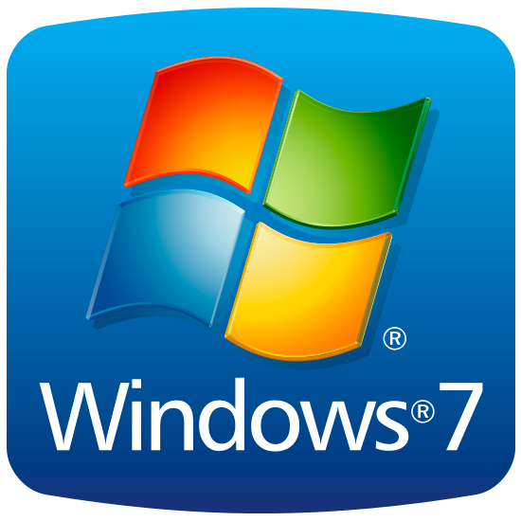


Tools

Slide 6
How Did We Select What Bits to mess With???
We looked at the entry points of these programs and from there picked instructions in the beginning, middle, and end of execution
X86 instructions are variable length, so the bits we flipped were within the area of our chosen instructions
We went on down the line and flipped and tested at will
Grady was responsible for automating the process with python and bash scripts

Slide 7
Our Programs
Dr. Liu’s Bomb
Simple simulated malware from Dr. Liu’s malware reverse engineering class running a bomb-puzzle you must solve, if you fail it you are infected in theory
Lab 01-02
This is a simple malware sample from Practical Malware analysis allowing you to see some malicious dlls run such as kernel32 and wininit, connects to the internet with wininit

Slide 8
Our Programs
Lab 01-04
This is another sample from Practical Malware analysis
Some dlls in this include kernel32 and ntdll
This malware will download unwanted file from Practical Malware Analysis book site
Also boots you from session when running in debugger
Lab 03-03
Replaces legitimate “svchost” image in memory with a keylogger.
Program exits but keylogger remains running.
Russian Ransomware
Locks the User from the OS and demands payment in exchange for unlocking

Slide 9
Findings - When the program broke
Illegal Instructions
Privileged instructions only kernel can execute
Bad Pointers
Segmentation Faults
Pointer does not land at the start of an instruction, cascading effect
Crashing the Stack
Push, Pop, Retn
Bad Instructions / Random Data Bytes in .text
Changed value didn’t correspond to a valid instruction
Cascading effect due to variable instruction length

Slide 10
Findings - When the program Worked or continued
CISC architecture is complex
Many instructions are equivalent under certain circumstances
Changing one instruction can result in that instruction being misinterpreted as multiple instructions
All of the instructions passed that instruction may be misinterpreted
Branches that aren’t normally taken
Bad pointer doesn’t matter if it isn’t followed
Different jump condition doesn’t matter if jump isn’t taken
Can replace jump condition with different instruction that has no effect
Logically equivalent values
1 and 2 are both evaluated as “TRUE” aka non-zero value

Slide 11
Findings - FUBAR aka Interesting Findings
Cascading effect can produce highly unpredictable results
Race conditions and deadlocks
Replaced a system call that obtains MUTEX with another valid system call that had no effect by changing library offset in syscall.
Program did not double check that it had the mutex before critical section. Blocking while waiting on MUTEX means that program will assume it has the mutex when execution continues.
Loading the program
Changing certain pointers affects how the program is loaded into memory. Observed that this always breaks the program.
Interrupts
May lead to interesting behavior depending on how the OS handles them
Far pointer vs Short w/ same address - Segmentation Fault

Slide 12
How Many Bits Did We Flip In Total?
215
164 out of the 215 total caused our samples to break
That’s a 75% chance you will break a program from flipping the bits

Slide 13
Takeaway - Potential Applications
Exploit Copy on Write deduplication with row hammer to change shared code such as a service or shared library on a multi-user system or cloud infrastructure
Gain access
Create a vulnerability such as buffer overflow, then follow up with normal attack
Denial of Service
Break a critical program or shared service
Mutating malicious code but preserving functionality
On the flip-side, detecting possible mutations

Slide 14
Takeaways: stopping Malware
There’s a 75% chance that you could flip a bit that would stop malware on your machine from what we found
This comes with understanding malware, what is run, etc.
Still having backgrounds in reverse engineering, none of us could have imagined such a high break-rate
Examples of ways to stop malware
Making retn into retf, this requires 0xC3 (hex of retn) to be flipped to 0xCB

Slide 15
More Examples of Ways We Saw to Break Malware
Mess with the jump target
jnz short loc_401652 -> jnz short near ptr loc_401652+2
750c -> 710e
0111 0101 0000 1100 -> 0111 0001 0000 1110
If branch is taken, this puts you in the middle of an instruction wrecking the execution
Add a non-multiple of 4 to the stack pointer
add esp, 4 -> add esp, 5
04C483 -> 05C483
0000 0100 1100 0100 1000 0011 -> 0000 0101 1100 0100 1000 0011

Slide 16
More Examples of Ways We Saw to Break Malware
Mess with the unpacking stub
Change the opcode of a cmp instruction
Cmp al, 1 -> Xor al, 1
Or just change a cmp instructions immediate value
Cmp al, 1 -> cmp al, 0
Change an instruction to a privileged instruction
Change the opcode of a je instruction
74 3a je 0x401573 -> F4 hlt
Change the target of a call
Original: ff 15 2c 20 40 00 call DWORD PTR ds:0x40202c
New: ff 15 2c 00 40 00 call DWORD PTR ds:0x40002c

Slide 17
In Conclusion...
This project was a very hands on project requiring us to work closely with the binary executables of our choice
We had the privilege of seeing the chain reaction caused by the flip of one single bit
We chose our bits from instructions but tried many different instructions and flipped many bits, one at a time
All things considered, we had a very high break rate
Given our findings, further study is definitely warranted

